Slide 1
Blockchain based Trusted Product delivery in E-commerce system
Supervised by:
Dr. Abu Sayed Md. Mostafizur Rahaman
Proffessor,CSE Department, JU
Presented by:
Monjur Ahmed -1834902019
Pranta Saha -1834902005

Slide 2
Contents of Our Talk
Introduction
Motivation
Problem Statement
Research Objectives
Proposed System
Experimental Result
Conclusion
References

Slide 3
Introduction
Blockchain is an emerging technology in the current world
It helps financial sector with its distributed, decentralized, transparent and immutable digital ledger technology.
Data can’t be manipulated by company or organizations.

Slide 4
Motivation
People are now getting everything they need from the internet very quickly
A decentralized app or d-app can be used in many aspects where trust is the focus point.
A multi-vendor E-commerce is an ideal example
Many vendors join it is tough to monitor all sellers for their product authenticity
A d-app with a smart contract can be a solution to this problem.

Slide 5
Problem Statement
Products not delivered in Time
Refund delays or sometimes merchant refused to refund
Scams in online shopping

Slide 6

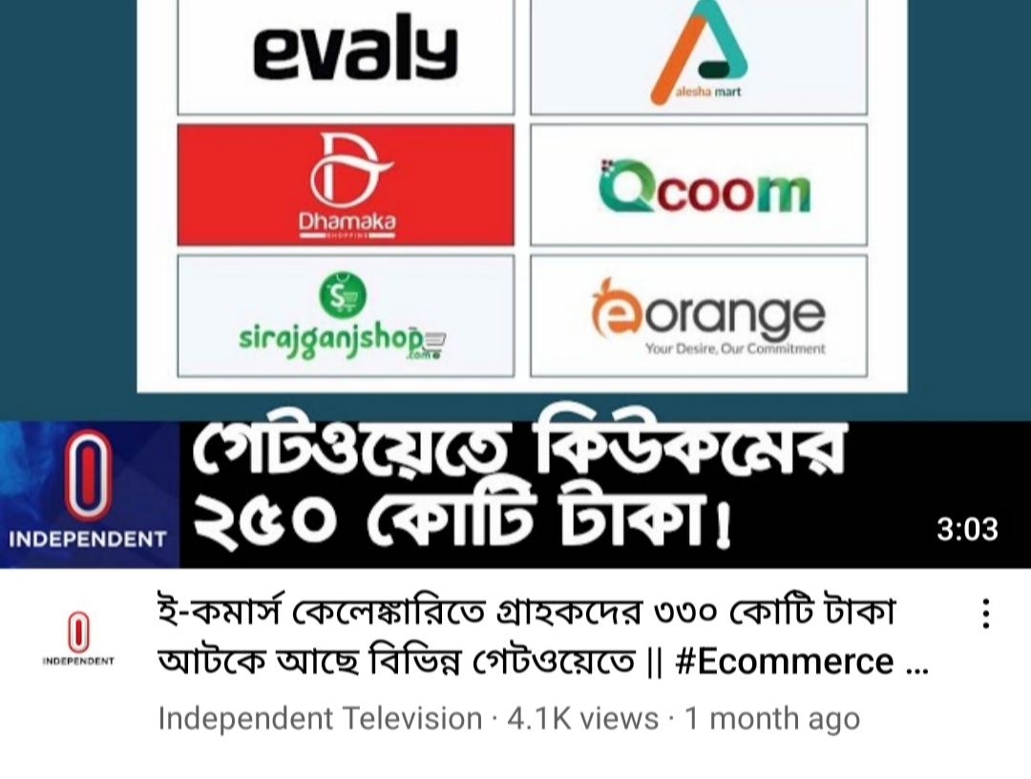



Slide 7
Research Objectives
Use blockchain as a middleman in E-commerce transactions
Eliminate third party ESCROW Service for E-commerce websites
Reduce Scams in Online Shopping
Transparency in Customer’s product delivery
Reinstating customer’s trust in E-commerce

Slide 8

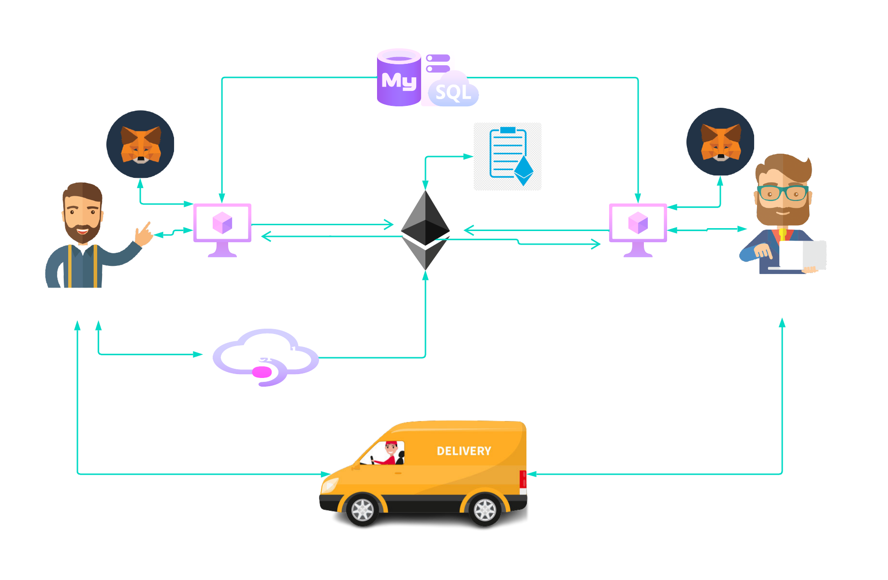
Proposed System

Slide 9




Process Flow
Step 1
Step 1
Buyer will choose a product which he/she intend to buy.
Step 3
Step 2
Courier service chosen.
If buyer does not there, as given buyer address product will go back to seller.
Step 4
Step 4
When courier service finds buyer, they will ask for a product key to confirm buyer.
Step 6
Step 5
If verification failed product will go back to seller
If verification is done exact amount of Ethereum of that product price will be deposited from buyer account to seller account

Slide 10
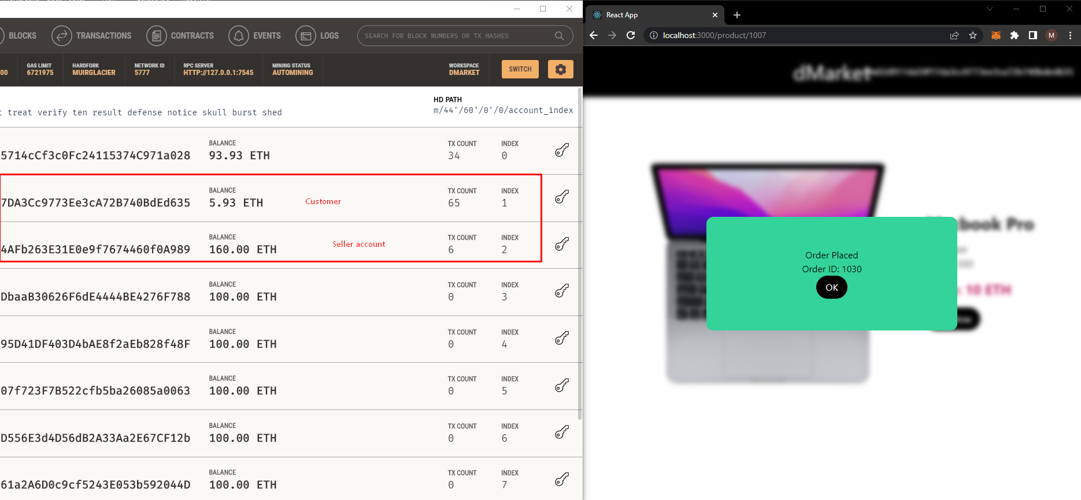
Experimental Result

Slide 11
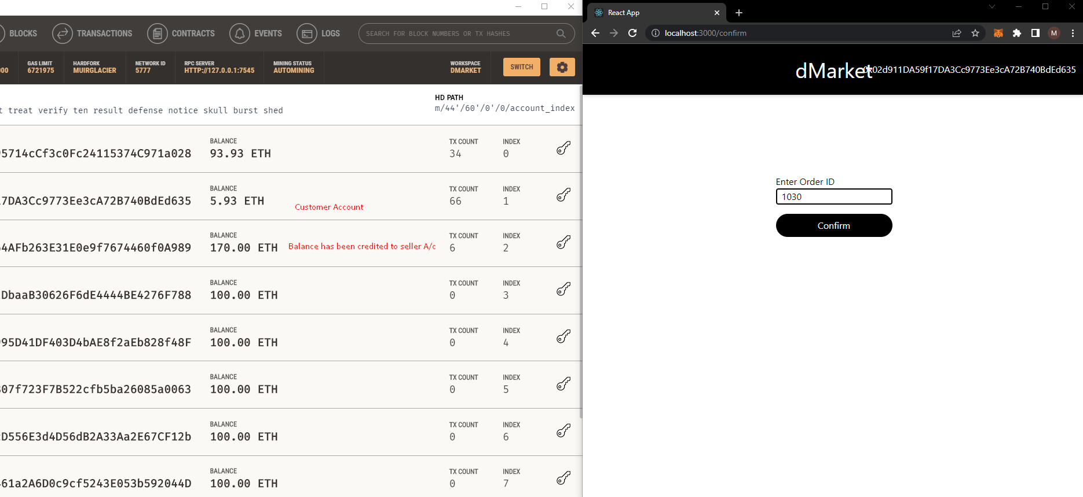
Experimental Result

Slide 12
Conclusion
In this proposed system we have implemented a trustworthy platform where no one can temper the transaction
The main fact of this system is that if the buyer didn’t get the actual product within the allocated time the deposited amount will be back by the system to the buyer’s account
After getting the product the buyer has to verify with a private key in the system and then the amount will be transferred in the seller’s account
This system will solve the supply chain major issue of trust.

Slide 13
References
What is blockchain technology? - IBM Blockchain. IBM. (n.d.). Retrieved June 12, 2022, from https://www.ibm.com/topics/what-is-blockchain.
11.48% customers victim of online shopping scams in 2020. Dhaka Tribune (2021, June 19), https://archive.dhakatribune.com/business/commerce /2021/06/20/11-48-customers- victim-of-online-shopping-scams-in-2020, last accessed June 2, 2022
Khatun, F. (n.d.). Digital platform economy and Bangladesh. The Financial Express. Retrieved June 13, 2022.

Slide 14
Thank you Any Question

